Slide 1
Preparing for REAC Inspections: The Quick and Easy
Southwest Housing Compliance Corporation
Presented by:
Brad Kothmann
Director of Property Standards &
REAC Inspector
July 23, 2015

Slide 2
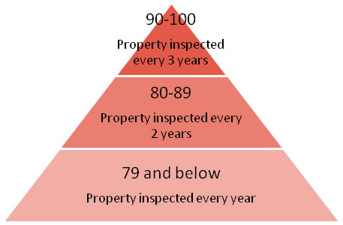
Preparing for REAC Inspections: The Quick and Easy
Takeaways:
  Understanding your property in REAC’s eyes.
  Your property profile, points breakdown and scoring.
  How to prepare and where to start.
  Best spent dollars (what do I repair?).
  “Day of” Tips.
  Assessing appealable items.

Slide 3
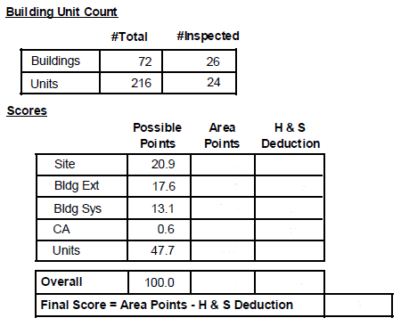
Preparing for REAC Inspections: The Quick and Easy
How is my property seen in REAC’s eyes?
The Property Profile will be confirmed by the Inspector the day of the inspection.

Slide 4
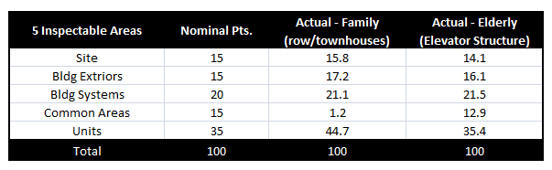
Preparing for REAC Inspections: The Quick and Easy
Your property starts with a pre-established Nominal Percentage for the 5 inspectable areas.
As items are entered N/A by the inspector, the nominal points will shift to align with the actual possible points for your property.
Therefore, it is very important for the inspector to get the Property Profile correct!

Slide 5
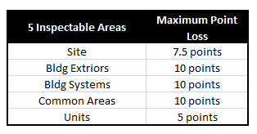
Preparing for REAC Inspections: The Quick and Easy
Each of the 5 inspectable areas has a Maximum Point Loss for a single deficiency.
Observed deficiencies will have 4 components:
1. Inspectable Area
2. Item Location
3. Defect Observed
4. Severity Level

Slide 6
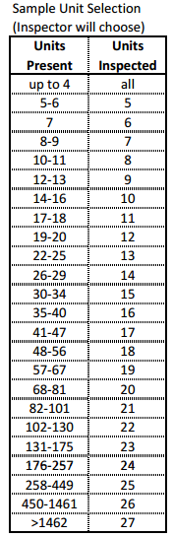
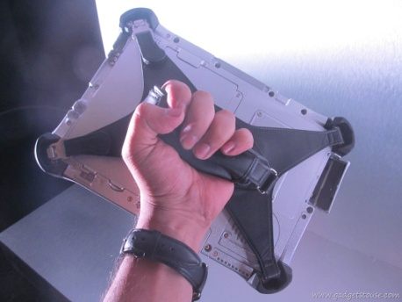
Preparing for REAC Inspections: The Quick and Easy
How is my property scored?
  A sample of units will be
  selected by the Inspector
  via REAC’s Rapid software.
As you can see, the more units you have the smaller the sample size is in comparison to the overall # of units

Slide 7
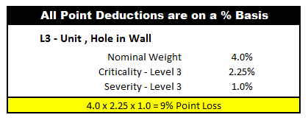
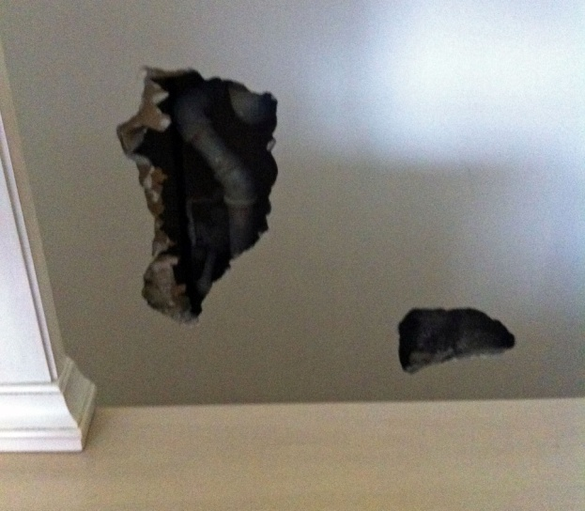
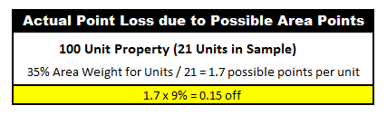
Preparing for REAC Inspections: The Quick and Easy
Remember that this is a snapshot in time and not all units and buildings, if multiple exists, will be inspected.
Scoring Example:
This hole is considered a Level 3 because it penetrates an adjoining room.
99.85

Slide 8
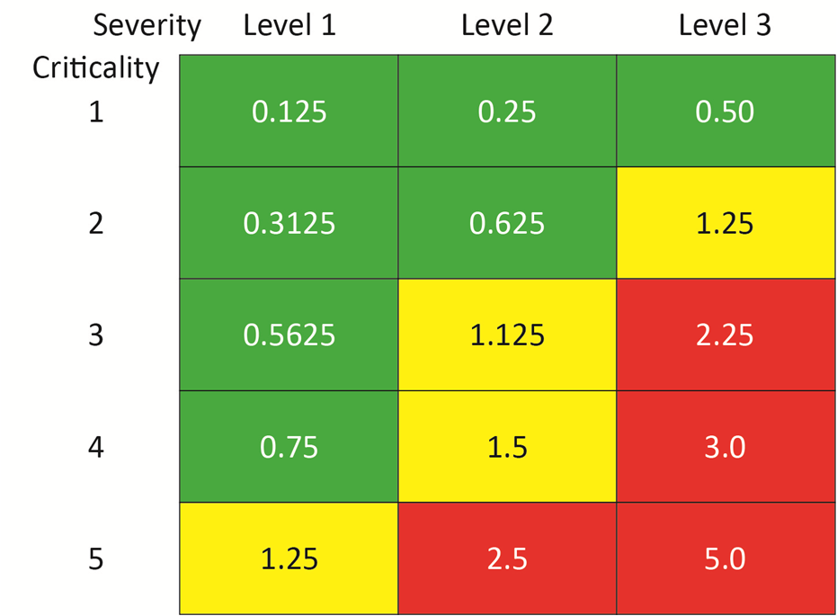
Preparing for REAC Inspections: The Quick and Easy
So How do I know the Weight, Criticality & Severity %’s?
  HUD’s Dictionary of Definitions Document
Higher the Criticality = Higher the Point Loss

Slide 9
Preparing for REAC Inspections: The Quick and Easy
Understanding Scoring & Levels
Deficiency Definitions
Site
Exposed
Wires
Level 3
9.4 points
Unit
Exposed
Wires
Level 3
1.3 points
Bldg Syst
Exposed
Wires
Level 3
0.7 points
Bldg Ext
Exposed
Wires
Level 3
0.7 points
* Based on a 21 Building Property with 100 Units

Slide 10
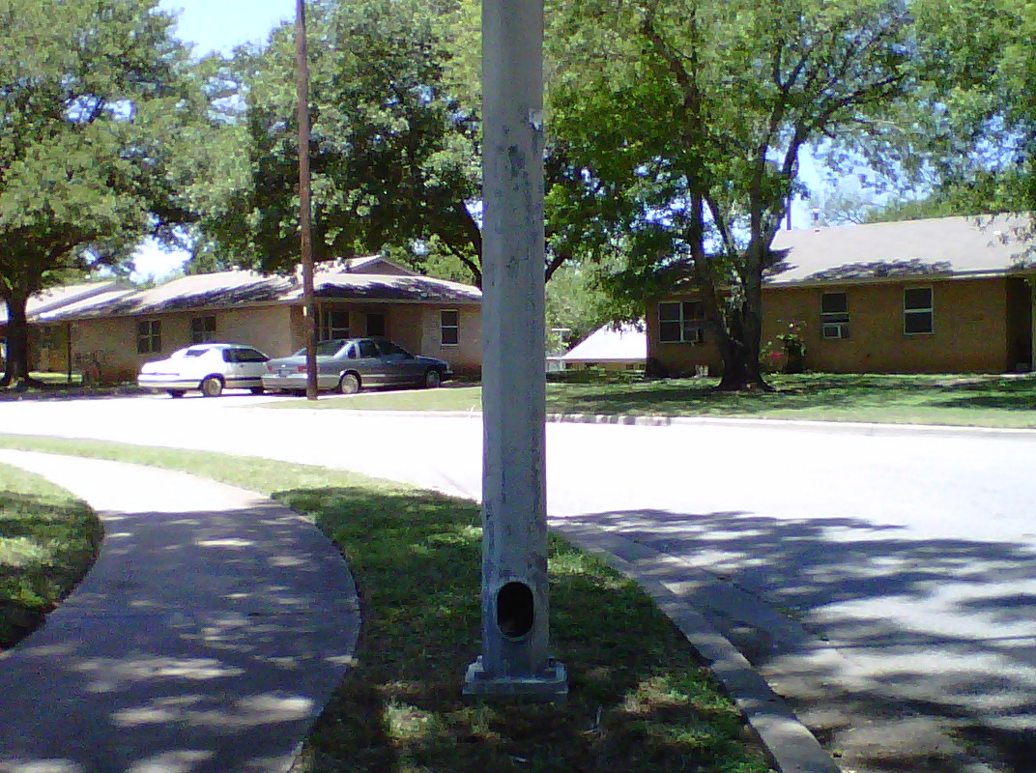
Preparing for REAC Inspections: The Quick and Easy
Scoring
Site: Exposed Wires - Level 3
(Area Points x Item Weight x Criticality x Severity)
15 x 0.125 x 5.0 x 1.0 = 9.4 points
7.5 points max. loss

Slide 11
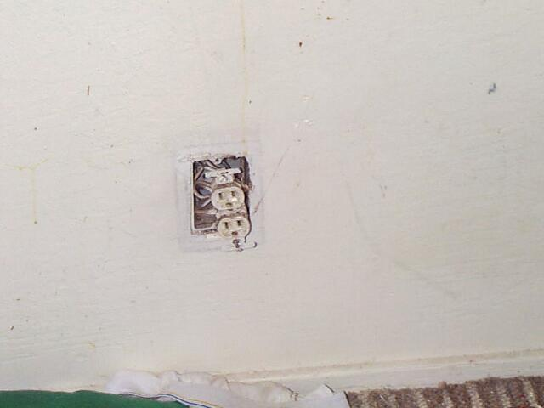
Preparing for REAC Inspections: The Quick and Easy
Scoring
Unit: Exposed Wires - Level 3
100 Unit Property – 21 Units Sampled
(Area Points x Item Weight x Criticality x Severity / # Units)
35 x 0.15 x 5.0 x 1.0 / 21= 1.3 points

Slide 12
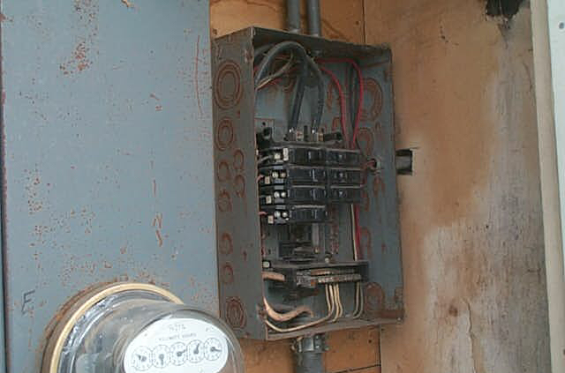
Preparing for REAC Inspections: The Quick and Easy
Scoring
Bldg Exterior: Exposed Wires - Level 3
28 Bldg Property – 21 Bldgs Sampled
(Area Points x Item Weight x Criticality x Severity / # Bldgs)
15 x 0.184 x 5.0 x 1.0 / 21 = 0.7 points

Slide 13
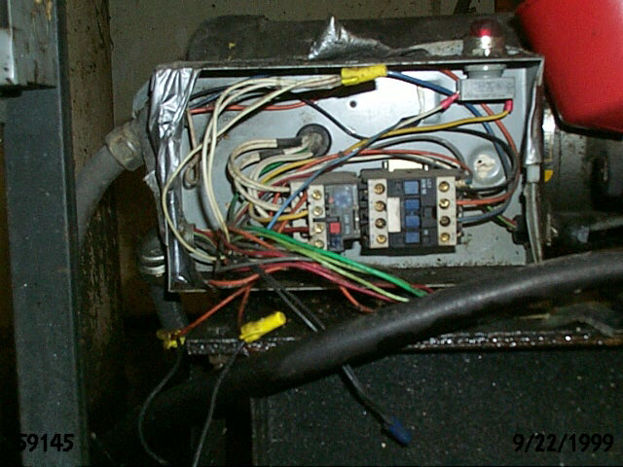
Preparing for REAC Inspections: The Quick and Easy
Scoring
Bldg Systems: Exposed Wires - Level 3
28 Bldg Property – 21 Bldgs Sampled
(Area Points x Item Weight x Criticality x Severity / # Bldgs)
20 x 0.155 x 5.0 x 1.0 / 21 = 0.7 points

Slide 14
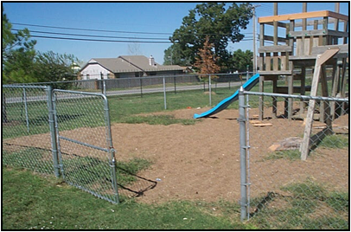
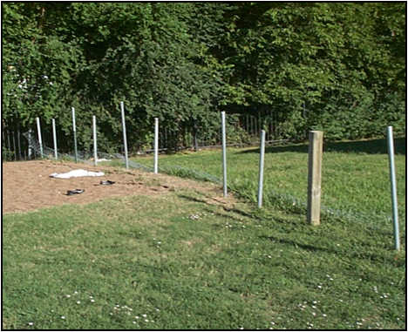
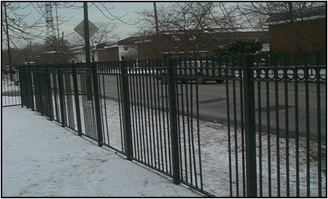
Preparing for REAC Inspections: The Quick and Easy
Just as important as understanding your point breakdown, is the understanding of the deficiency itself.
Damaged / Missing Gates
4.5 Points – Safety/Security
Missing gate designed to keep
children in or out.
Damaged / Falling / Leaning
1.7 Points – Non Safety/Security
Privacy fence – missing sections,
greater than 25%.
Holes / Missing Sections
4.5 Points – Safety/Security
Missing sections. Designed to
keep people in or out.

Slide 15


Preparing for REAC Inspections: The Quick and Easy
Ok, so that is all good information, but where do I start when preparing for the inspection?
  A good place to start is your last
  inspection.
    Look for systemic deficiencies.
    Take note of units inspected.
    Confirm all deficiencies were
    mitigated.
  Review HUD Guidance and any
  Previous Training Materials
    Top 20 Deficiencies (National)
    Top 25 Deficiencies –
    Multifamily
    “Preparing for REAC
    Inspections” Guidance
Remember: The site is the most important area, because it is never diluted in points and as such the % point losses result in higher point deductions!

Slide 16
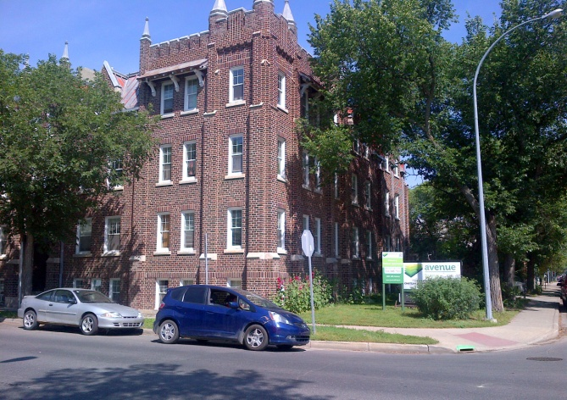

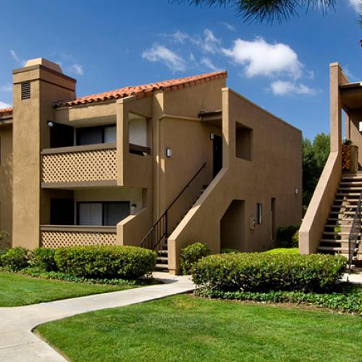
Preparing for REAC Inspections: The Quick and Easy
Conduct a Complete 100% Inspection of the Property.
  Ensure staff understand the importance of the inspection and achieving a high score.
  Follow the same format as the inspector will:
    Site Inspection
    Building Exterior(s) Inspection
    Building System(s) Inspection
    Common Area Inspection
    Unit Inspection - ALL

Slide 17
Preparing for REAC Inspections: The Quick and Easy
Download the Same Inspection Software the Inspector will use to Perform the Inspection (Public Version) and Perform your Own Inspection.
  Rapid 4.0
  It is Available in Hard Copy as well.
Having a Copy of the Following Documents Available is a good idea as well:
      REAC Compilation Bulletin / Protocol
      Dictionary of Definitions

Slide 18
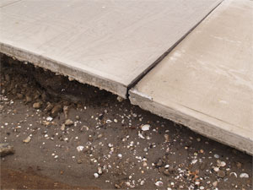
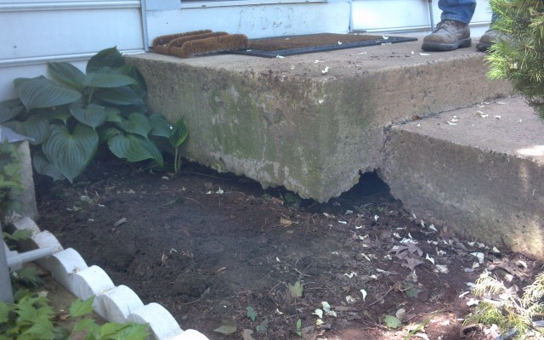
Preparing for REAC Inspections: The Quick and Easy
Let’s look at the SITE a little more with common issues I see:
Erosion

Slide 19
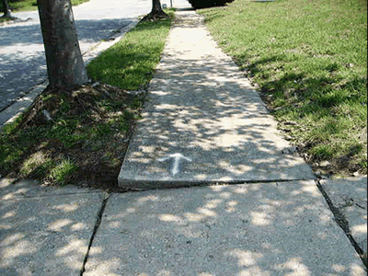

Preparing for REAC Inspections: The Quick and Easy
Trip Hazard
Overgrown Vegetation

Slide 20
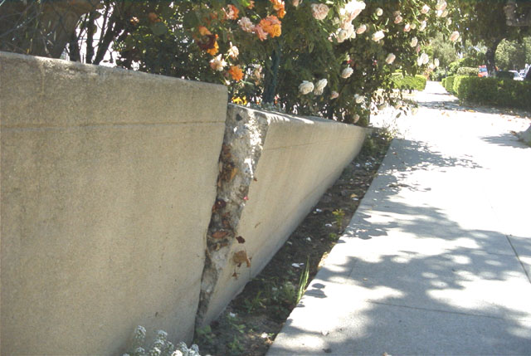
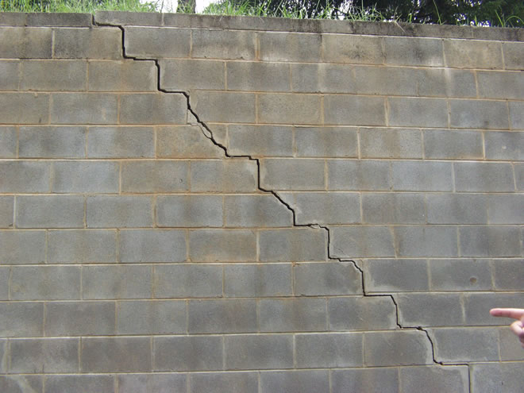
Preparing for REAC Inspections: The Quick and Easy
Damaged Retaining Walls

Slide 21
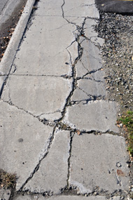
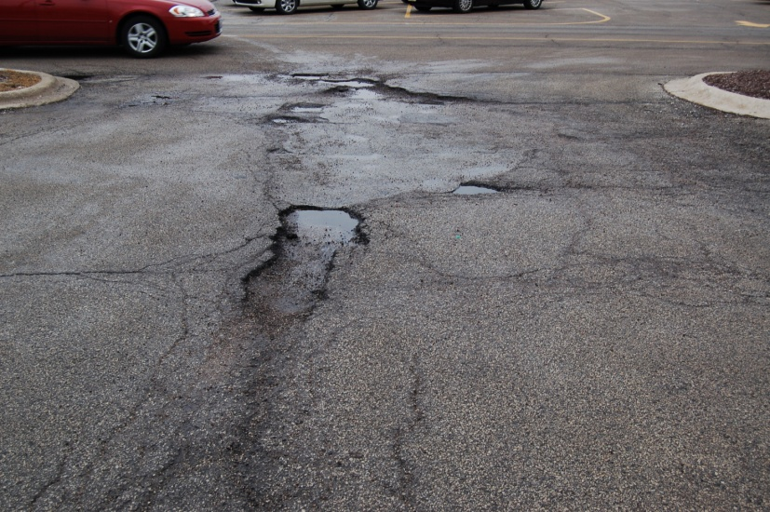
Preparing for REAC Inspections: The Quick and Easy
Cracked Sidewalks
Potholes

Slide 22
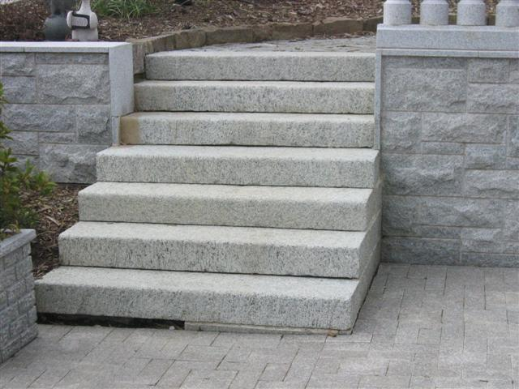
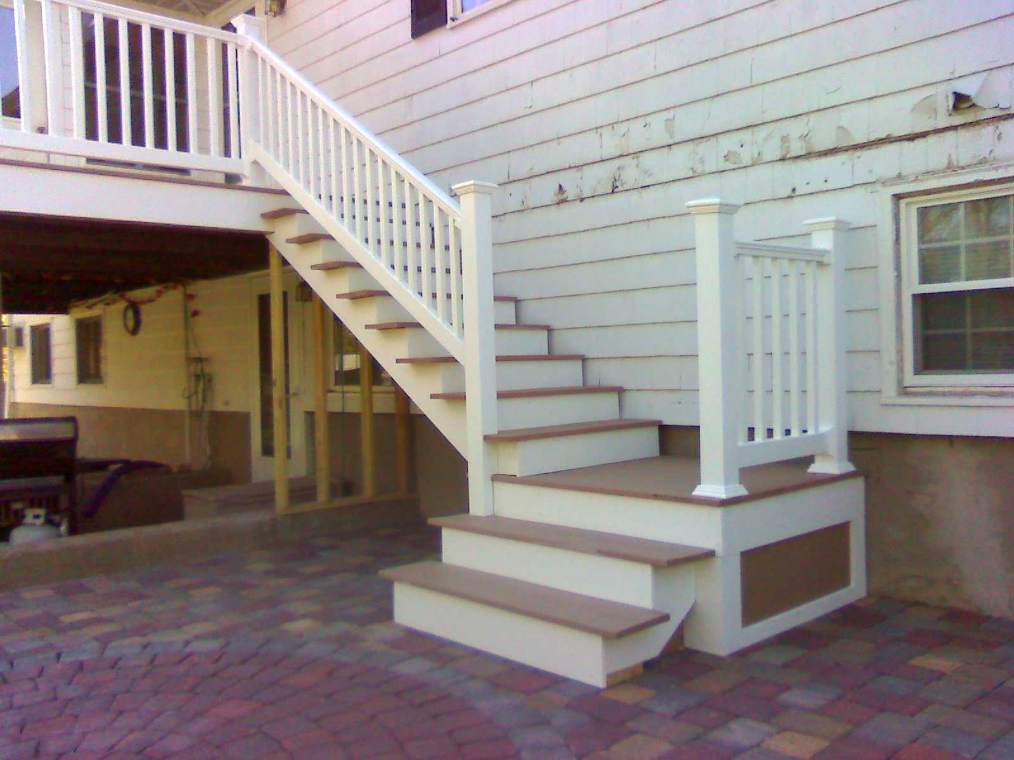
Preparing for REAC Inspections: The Quick and Easy
Missing Handrail
If you lift your feet more than 3 consecutive times, a handrail is required!
Landing Exception

Slide 23
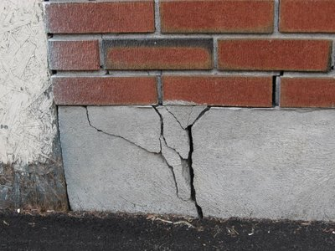
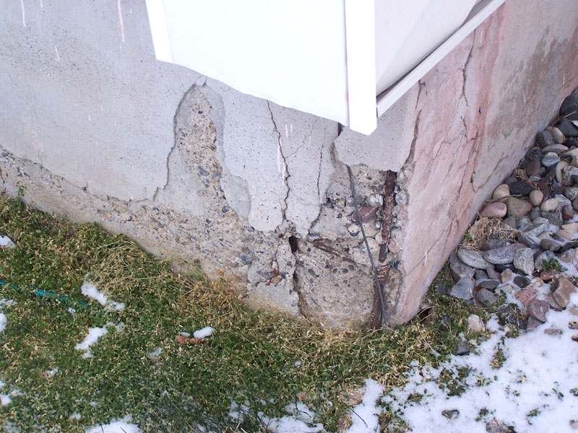
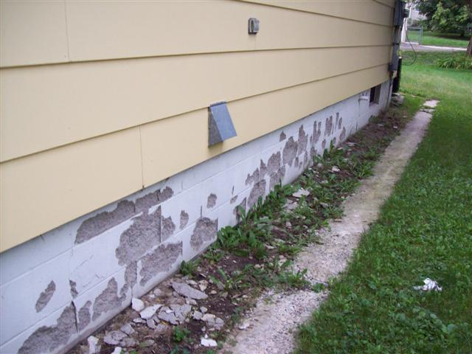
Preparing for REAC Inspections: The Quick and Easy
Now for Building Exteriors:
Foundation Cracks & Spalling

Slide 24
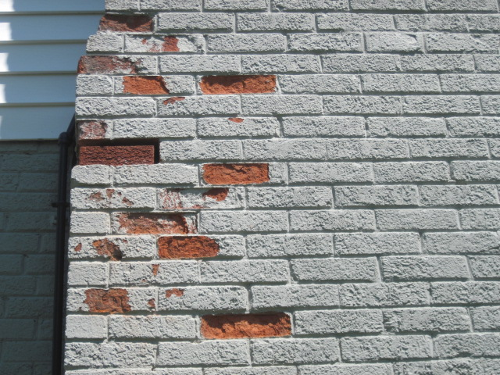
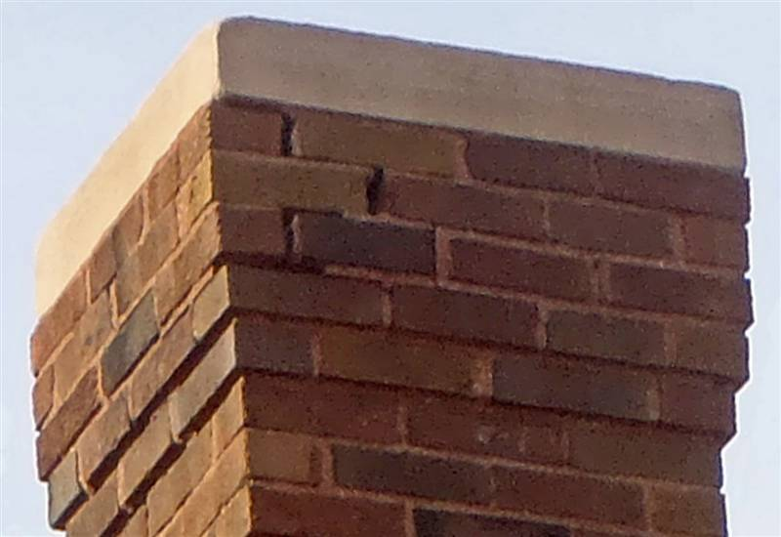
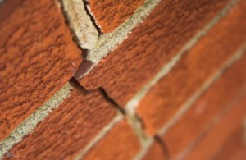
Preparing for REAC Inspections: The Quick and Easy
Cracks in Walls, Missing Mortar & Missing Pieces

Slide 25
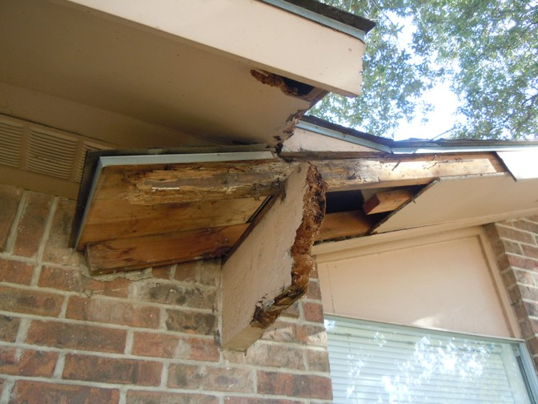
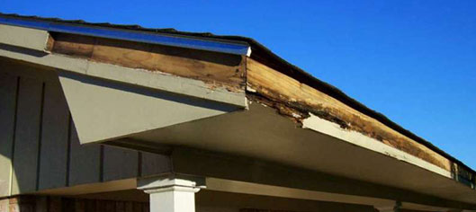
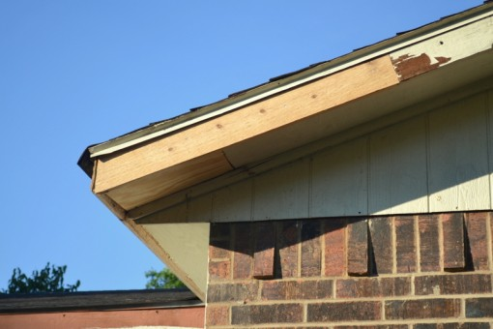
Preparing for REAC Inspections: The Quick and Easy
Damaged Fascia Boards & Soffits

Slide 26

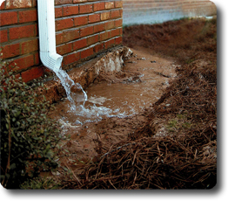
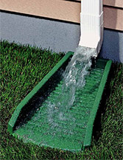
Preparing for REAC Inspections: The Quick and Easy
Broken Fixtures
Missing Splash Blocks

Slide 27
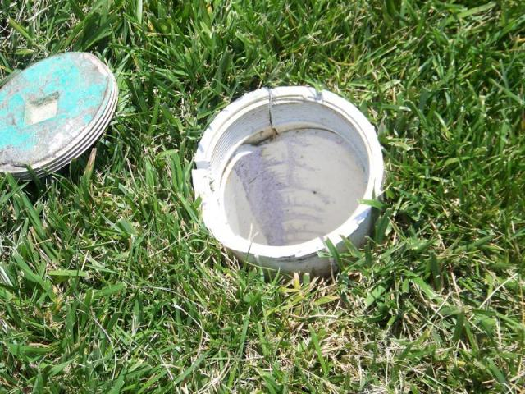
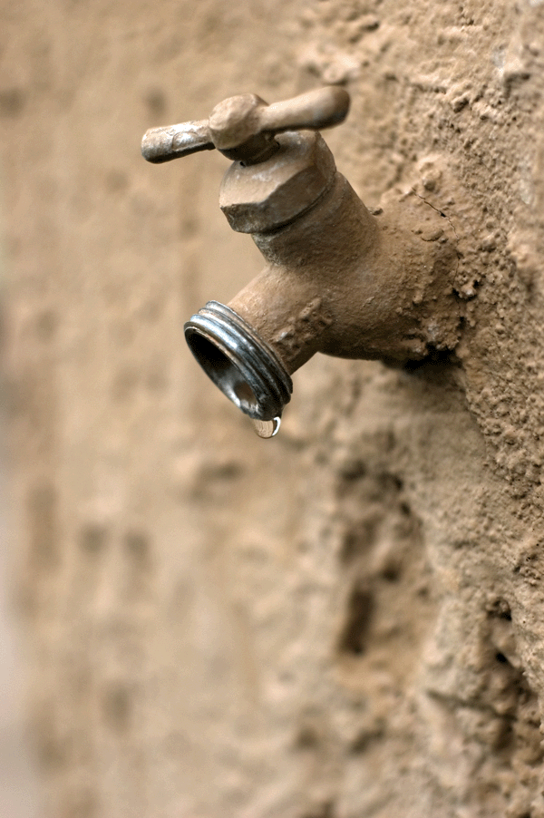
Preparing for REAC Inspections: The Quick and Easy
Did I Mention Building Systems?
Missing Cleanout Cover
Leaking Hose Bib

Slide 28
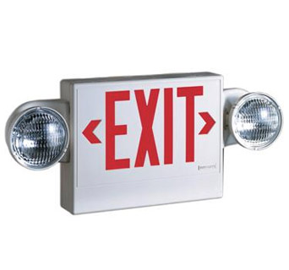
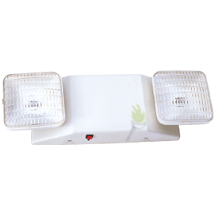
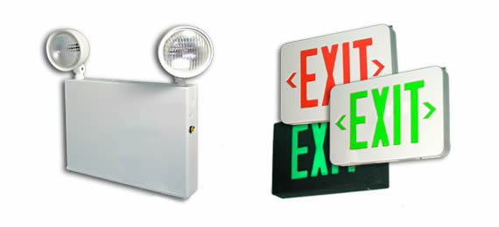
Preparing for REAC Inspections: The Quick and Easy
Emergency Lighting & Exit Signs

Slide 29
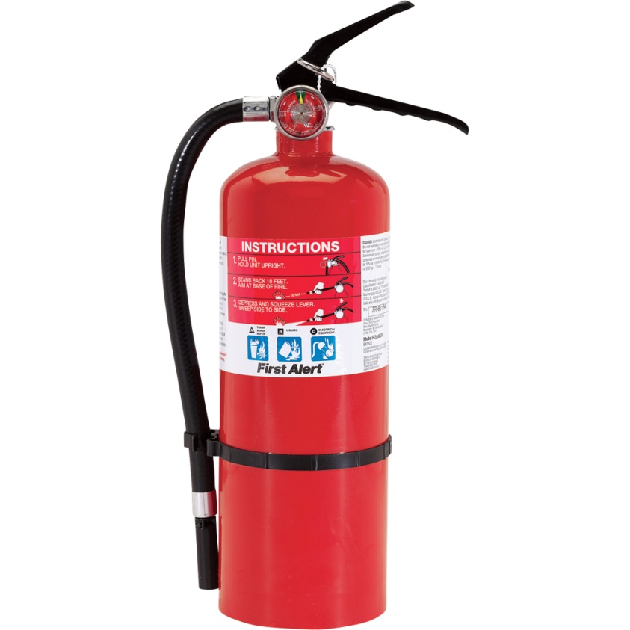
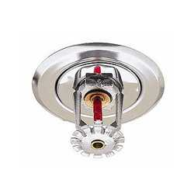
Preparing for REAC Inspections: The Quick and Easy
Fire Extinguishers
What is Missing?
Paint on Sprinkler Head
Is the Ring Present?
This is one of the highest Bldg Syst point loss items regardless of area located (CA/Units)!

Slide 30
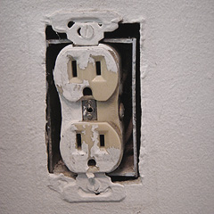
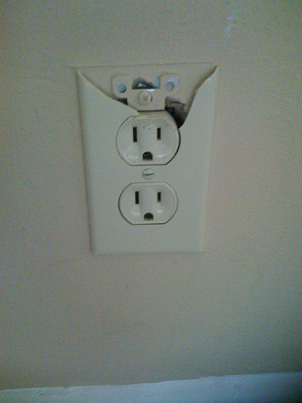
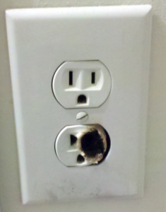
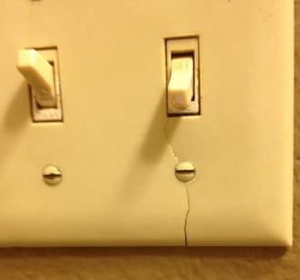
Preparing for REAC Inspections: The Quick and Easy
Resident Damage or Normal Wear & Tear?...Now we will talk about the Common Areas and Units.
Cracked / Missing / Broken Electrical Outlets & Plates
Rounded Ground Eye

Slide 31



Preparing for REAC Inspections: The Quick and Easy
Torn Refrigerator / Freezer Gaskets
Are They Worth the Fix?

Slide 32



Preparing for REAC Inspections: The Quick and Easy
Dryer Vents
MUST Have Water Too!

Slide 33





Preparing for REAC Inspections: The Quick and Easy
Holes & Peeling Paint on Walls / Ceilings

Slide 34



Preparing for REAC Inspections: The Quick and Easy
Rust / Corrosion on Hot Water Heater

Slide 35



Preparing for REAC Inspections: The Quick and Easy
Breaker Boxes
Check These Too…
Allowed ¼”

Slide 36
Preparing for REAC Inspections: The Quick and Easy
While we are on breaker boxes (electrical boxes) lets review HUD’s Protocol for Inspecting Such Devices.
  Timer Boxes
  Disconnect Boxes
  Panel Boxes
  This document provides direction to the inspectors when they come across such Electrical Boxes.
    Mostly regarding the Lock / Unlocked aspect.
My recommendation is to Zip Tie Shut or Lock all like type boxes; however, ensure Panel Boxes are ok inside.
The Inspector MAY NOT remember they have to open them!

Slide 37



Preparing for REAC Inspections: The Quick and Easy
Inspection Day is Here
  Have all necessary information available for the inspector:
    Notification Letter
    Property Map
    Rent Roll
  Escort the Inspector how you would like to proceed. They will let you know if they have issues with the route.
  Don’t question every deficiency. Be selective.
    An irritated inspector is not good.
  Take notes and pictures of ALL deficiencies identified by the inspector. They are required to call ALL of them out, along with the Level.
    Make sure camera’s day/time stamp is accurate. This will help with any appeal items.

Slide 38
Preparing for REAC Inspections: The Quick and Easy
Should I Appeal Deficiencies Noted by the Inspector that we Do Not Agree with?
HUD / REAC Encourages Owner / Agents to Submit Appeals for Deficiencies Indentified that are Questionable.
There are 2 Types of Appeals:
  Technical Reviews
  A review of…..material errors!
  Database Adjustments
  A review of…..things outside your control
The Answer is ALWAYS YES!

Slide 39
Preparing for REAC Inspections: The Quick and Easy
What is a Technical Review?
  An Objectively Verifiable and Material error that could result in a higher score.
    Property Profile Errors
    Non-Existent Deficiencies
  These are the Most Common
  However, you can’t appeal:
    Level of Deficiencies
    Corrected Deficiencies
    0 Point Loss Deficiencies
What is a Database Adjustment?
  Requested for circumstances that are out of the ordinary.
    Local Conditions & Exceptions
    Ownership Issues
    Conditions Beyond the Owner’s Control
    Modernization Work

Slide 40
HUD Notice H2015-02
New rules and procedures for properties that receive a score of less than 60 on a REAC inspection
  Failing a REAC Inspection is not something you plan for, can be stressful, and have a huge administrative burden.
  Previous guidance was lacking, or grey in areas and this new Notice creates a more defined process for getting out of non-compliance and back in good standing with HUD.
  The guidance appears to be relatively easy to follow.

Slide 41
HUD Notice H2015-02
The New Notice establishes a “first fail
date” of January 17, 2014. Enforcement
actions will take place on properties
that have two or more fails after this
date.
Properties need to notify their HUD Account Executive of your intent to file an appeal. This technically puts the enforcement actions on hold until a decision is made.
  Favorable Decision = No further action
  Non Favorable Decision = 60 day enforcement
  action is taken
HUD will notify the property of a required response period and explain the failed REAC inspection protocol.

Slide 42
HUD Notice H2015-02
A CDE plan will be created with a timetable for correcting all deficiencies. Included will be:
    100% inspection of entire property.
    Repair of all indentified deficiencies or submit an action plan.
    Property will execute a certification that the project is fully compliant with UPCS standards.
Property must notify all tenants of the Owner’s non-compliance.
    Specific form is included in the Notice: “Notice of Compliance, Disposition, and Enforcement (CDE) Plan”.

Slide 43
HUD Notice H2015-02
For a first time below 60, re-inspection will occur within one year. This is assuming that the NOV / NOD has been cured within the 60 day period.
  If not, inspection will be sooner and the property will remain flagged in APPS.
A property that scores 30 or below, or two fails after January 17, 2014, will be referred to the Departmental Enforcement Center (DEC). The DEC will then decide upon the type of enforcement to be applied, including:
  Civil money penalties
  Abatement or partial abatement of the HAP contract
  Reassignment of management or ownership.
  Seek receivership or judicial order.

Slide 44
Questions?
Brad Kothmann, Director of Property Standards
& REAC Inspector
(512) 767-7712 / BradK@SHCCnet.org

